Slide 1
I. Experience Python

Slide 2
Downloading Python
http://www.python.org/download

Slide 3
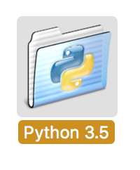
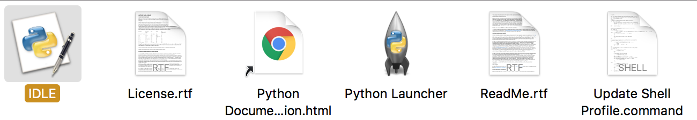
IDLE

Slide 4
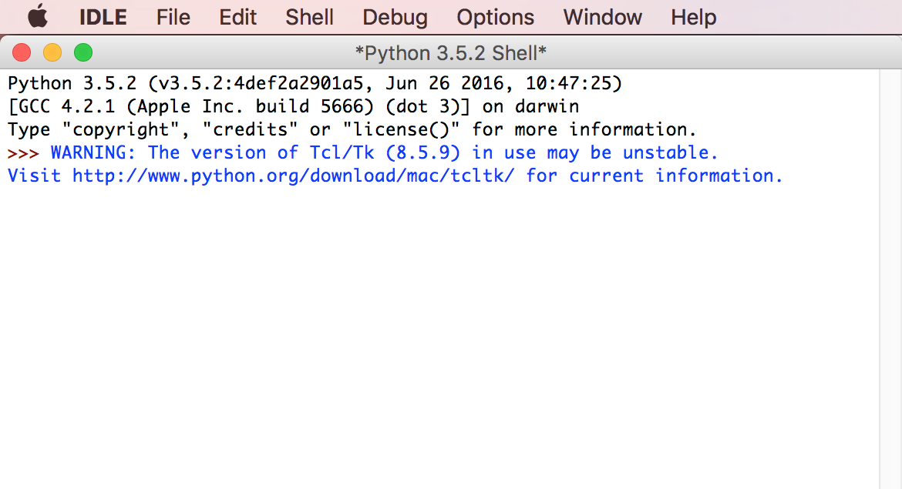

Slide 5
What is python?
A Programming Language that is really easy to learn!
Other Languages:
Java
C++
Etc.

Slide 6
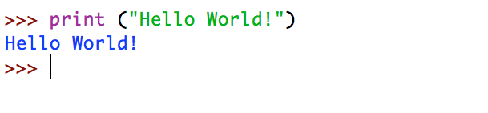
Print
print (“Hello World!”)

Slide 7

Turtle

Slide 8
turtle
import turtle
alex = turtle.Turtle()
Turtle name
Turtle class
Turtle method

Slide 9
turtle methods
Method | Description
.forward(distance) | Moves forward a certain distance
.backward(distance) | Moves backwards a certain distance
.right(angle) | Rotates CW to a certain angle
.left(angle) | Rotates CCW to a certain angle
.setposition(x,y) | Sets turtle to a certain position
.penup() | Lift pen up (can still move around but won’t draw)
.pendown() | Put pen down (moves around and draws)
.pencolor(color) | Changes turtle pen color eg. (“blue”, “orange”)

Slide 10
(More) turtle methods
http://interactivepython.org/runestone/static/IntroPythonTurtles/Summary/summary.html

Slide 11
Simple functions
Def indicates a function
Function name
Function parameters
def triple (num):
return num*3

Slide 12
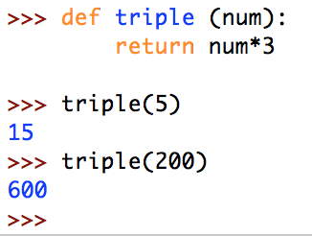
Simple functions

Slide 13
1. Example functions
def exampleOne (num1, num2, num3):
return num1 + num2 + num3

Slide 14
2. Example functions
def exampleTwo (word1, word2):
return word1 + “ ” + word2

Slide 15
1. WRITE YOUR OWN function
1. Write a function that calculates the area of a rectangle (given width, height)
>>> area (5, 3)
15
>> area (4.2, 3.2)
13.44

Slide 16
2. Write your own function
2. Write a function that calculates the perimeter of a rectangle (given width, height)
>>> perimeter (5, 3)
16
>> perimeter (4.2, 3.2)
14.8

Slide 17
1. WRITE YOUR OWN FUNCTION (solution)
def area(width, height):
return width*height

Slide 18
2. Write your own function (solution)
def perimeter(width, height):
return 2*width+2*height

